Slide 1
VeriDegree_Dapp Blockchain Credentials Project
Software Development
Student name: Eskandar Atrakchi
x23137517
(BSHCSD4)
Final Year Project

Slide 2
Main idea
VeriDegree is a Dapp
Immutable Credentials
Instant Validation
Total User Control
Fraud Elimination

Slide 3
01
02
03
The Problem with Traditional Certificates
Paper and PDF certificates are easy to manipulate
Verification requires manual contact with institutions
Students do not truly own their credentials
04
Companies waste time verifying educational history
05
No universal trusted system for instant verification

Slide 4
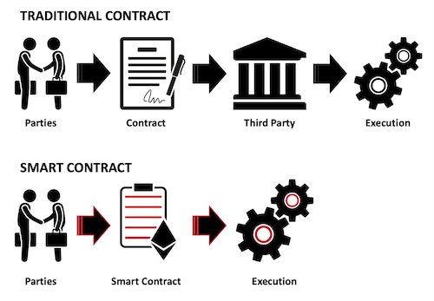
Blockchain-Based Certificate Issuance & Verification
Institutions issue certificates as soulbound NFTs
Students own their certificate in their Web3 wallet
Verifiers simply enter a wallet address → instant validation
Certificates stored on IPFS, decentralized and tamper-proof
Fully transparent, trustless, and impossible to forge

Slide 5
How VeriDegree Works
Issuer Dashboard: Issue certificate → Upload image → IPFS metadata → Smart contract mint
Smart Contract:
Non-transferable Soulbound NFTs
Prevents duplicates
Public on-chain certificate info
Viewer Dashboard: Students view certificate + IPFS image
Verifier Dashboard: Enter wallet → Fetch NFT → Display certificate + metadata
Transparent accessible nodes

Slide 6
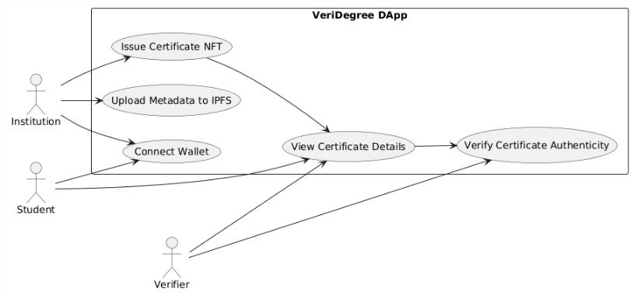
Technical stack
Blockchain & Smart Contracts
Solidity
ERC-721
Soulbound NFT Logic
Sepolia Testnet
Frontend Development
Next.js
React.js
Tailwind CSS
TypeScript
Development & Testing Tools
Hardhat
Node.js
Remix IDE
Web3 Integration
MetaMask
Decentralized Storage
IPFS (InterPlanetary File System)
Pinata
Deployment & DevOps
Vercel
GitHub Actions

Slide 7
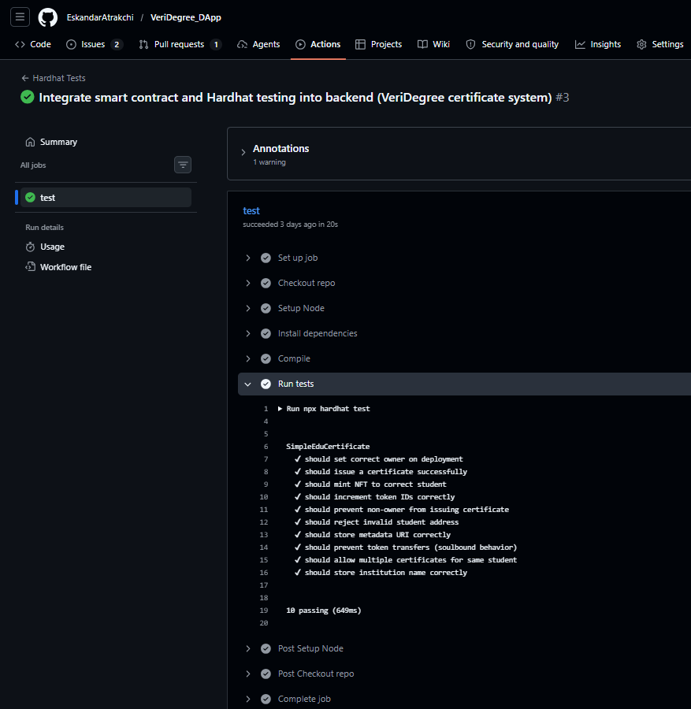
Cloud testing
GitHub Actions is used for testing (Live testing next)

Slide 8
Why VeriDegree Is Different
Verification with only a wallet address (no PDFs, no database)
True ownership via Soulbound NFTs
End-to-end decentralization IPFS + Smart Contract + Web3

Slide 9

Any Questions?

